Slide 1

Fake Reviews Detection System & Product Real Rating
Supervised by
Dr. Mustafa Elgendy

Slide 2

OUR TEMA
Amr Awni
Ibrahim Mohamed
Mohamed Elhalawany
Engy Salah
Doha Masoud
Rahma Ayman
Leqaa Mohamed
Saja Rafat
Sandy Esam
Soad Eslam

Slide 3

Abstract

Slide 4
Introduction
E-commerce
Impact of reviews

Slide 5
What is the problem?

Slide 6
objective
Our project aims to counter fake reviews and provide trustworthy information for a transparent online marketplace.

Slide 7
Methodologies

Slide 8

AI Features
Our system boasts many features that enhance online shopping, including:
Spam detection
Review Summarization
Sentiment analysis

Slide 9
AI Features
Our system boasts many features that enhance online shopping, including:
Spam detection
Review Summarization
Sentiment analysis

Slide 10
Review Summarization
we have tested and compared two models
1- from scratch model Depends on RNN(LSTM)
2- pretrained model depends on transformer (simplet5)
Model name | accuracy
LSTM | 78%
simplet5 | 94%
We can find that simplet5 is more effective than LSTM

Slide 11
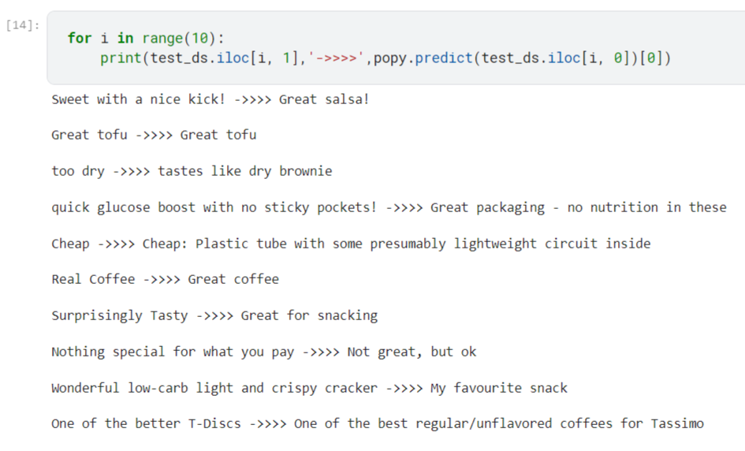
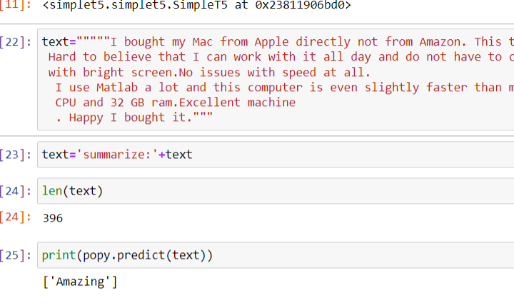
Review Summarization
Local screen indicates:
The Actual and expected summary.
The summarized review .

Slide 12
AI Features
Our system boasts many features that enhance online shopping, including:
Spam detection
Review Summarization
Sentiment analysis

Slide 13
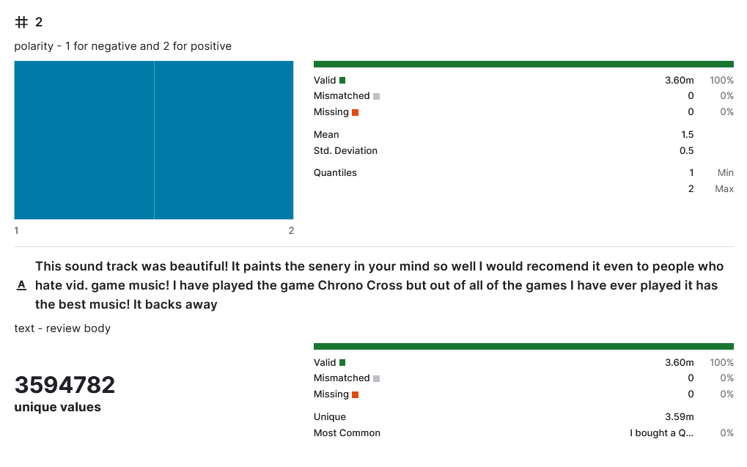
Dataset
The dataset contains about:
1,800,000 samples in each polarity sentiment.
3 columns:
polarity - 1 for negative and 2 for positive
we replaced it (0 for negative and 1 for positive).
title - review heading we dropped it.
text - review body.
Unique values.
No null values.
No missing values.

Slide 14
Sentiment analysis
Model Name | Training Accuracy | Validation Accuracy | Confusion Matrix
Logistic Regression | 0.903046875 | 0.838125 | [1359, 251] [ 267, 1323]
KNN | 0.762109375 | 0.72375 | [1114, 496] [ 388, 1202]
Decision Tree | 0.718203125 | 0.683125 | [1358, 252] [ 762, 828]
SVC | 0.988828125 | 0.8425 | [1367, 243] [ 261, 1329]
Random Forest | 0.846640625 | 0.801875 | [1258, 352] [ 282, 1308]
XGB | 0.933203125 | 0.8115625 | [1318, 292] [ 311, 1279]
DistilBERT | 0.924091 | 0.914091
Models

Slide 15
Sentiment analysis
Model Name | Training Accuracy | Validation Accuracy | Confusion Matrix
Logistic Regression | 0.903046875 | 0.838125 | [1359, 251] [ 267, 1323]
KNN | 0.762109375 | 0.72375 | [1114, 496] [ 388, 1202]
Decision Tree | 0.718203125 | 0.683125 | [1358, 252] [ 762, 828]
SVC | 0.988828125 | 0.8425 | [1367, 243] [ 261, 1329]
Random Forest | 0.846640625 | 0.801875 | [1258, 352] [ 282, 1308]
XGB | 0.933203125 | 0.8115625 | [1318, 292] [ 311, 1279]
DistilBERT | 0.924091 | 0.914091
Models
We can find that DistilBERT is more effective with
0.92%

Slide 16
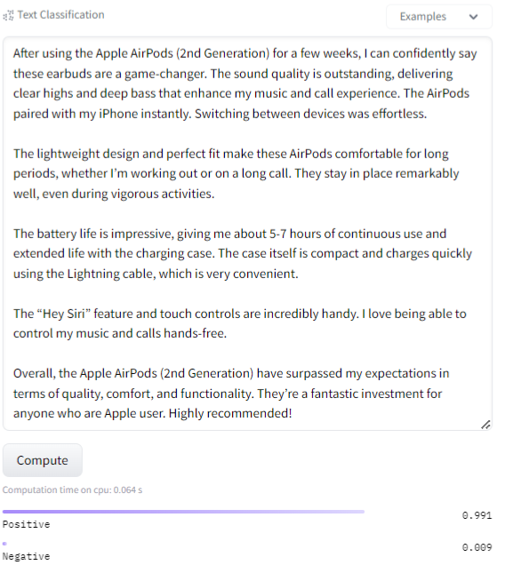
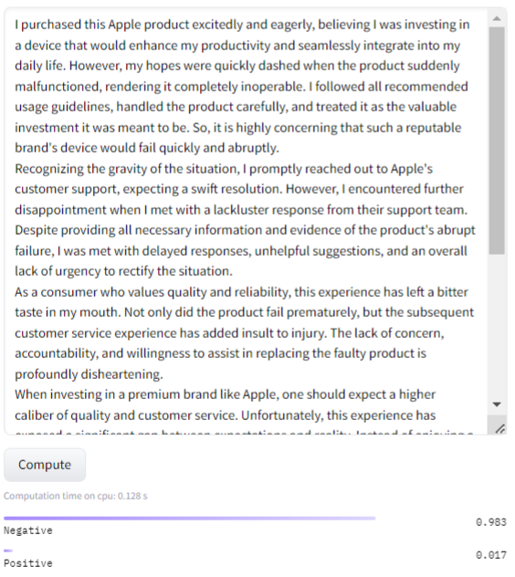
Sentiment analysis
Local screen indicates:
The prediction of our model

